Slide 1
Tax Tech Team– Hackathon 2022
Name Pronunciation Tool

Slide 2



Technology Stack
Azure Cognitive Services
.Net Core
SQL server Database

Slide 3
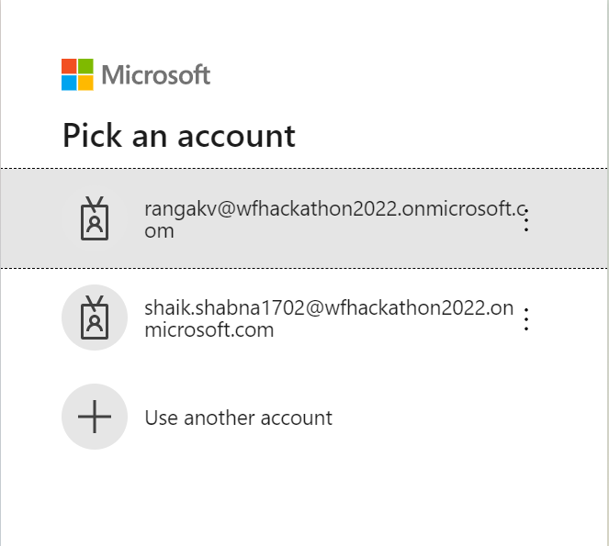
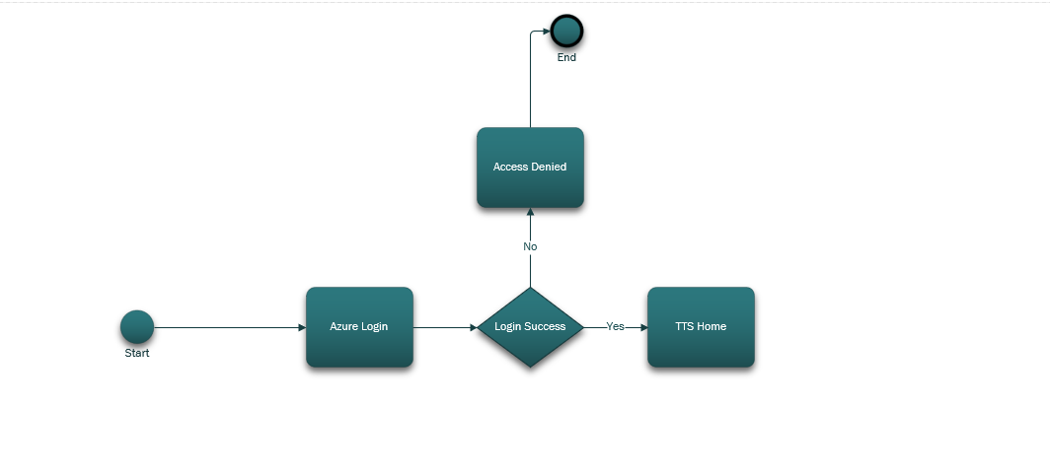
Login Screen
UI Screen
Role based AD group authorization and authentication using OAuth is being used for Login screen
Design Flow Diagram

Slide 4
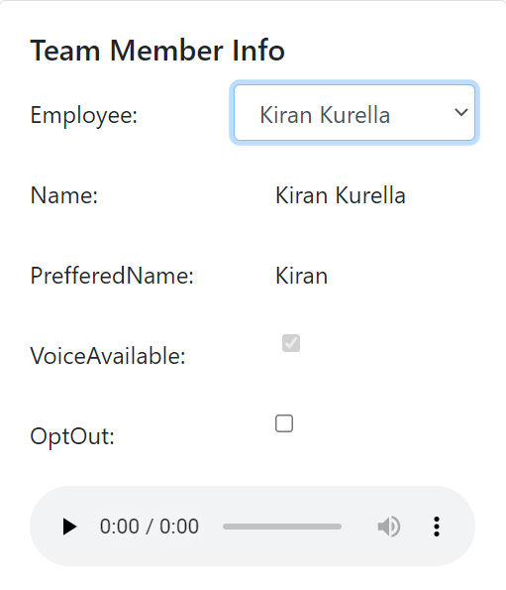
Employee Flow
UI Screen
Design Flow Diagram
Blob storage is being used for storing the audio files of employee voice recordings
Note:
A temporary Database with list of employees is created as a substitute due to limitations of LDAP integration

Slide 5
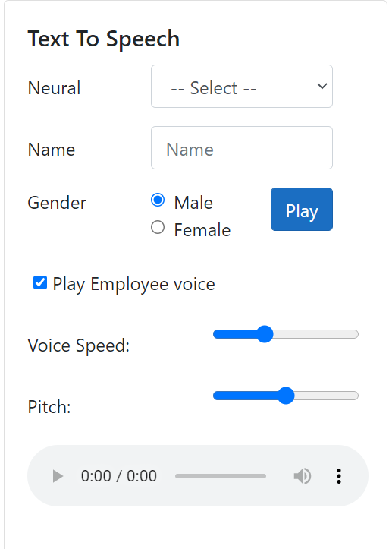
Voice Search
UI Screen
Design Flow Diagram
Cognitive Services are being used for Text to voice search
Key Vault services are used for securely storing keys
SQL server DB service is being used to connect to Database

Slide 6
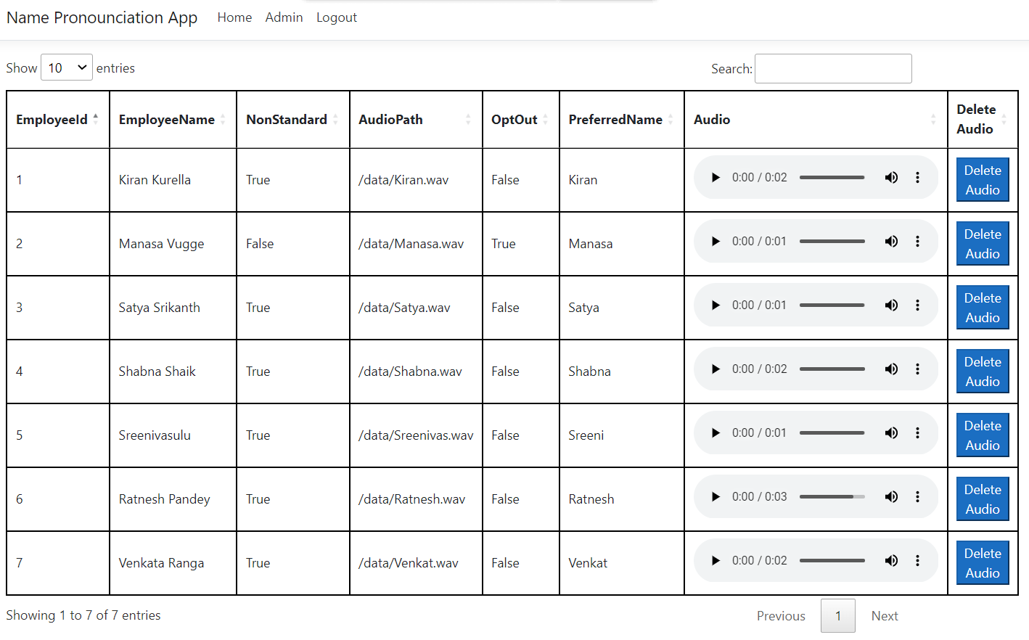
Admin Module
UI Screen
Admin has ability to play the voice and delete audio as needed

